Slide 1

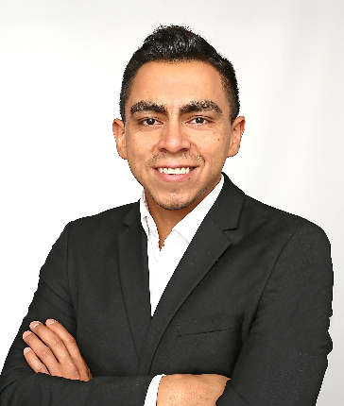
Frankfurt, Germany
Mario Monsreal Foreign Offices Director & Director Europe
Mario Monsreal serves as Foreign Offices Director & Director Europe with the Missouri Department of Economic Development and is based in Frankfurt, Germany.
Mario brings a wealth of experience to this role, having previously served different governments from North and Latin America, Europe, and the Middle East advising them in FDI attraction and foreign trade. In this capacity, formerly as Director Germany and Central Europe and currently as Foreign Offices Director with the State of Missouri, he played a pivotal role in organizing important Governor’s Trade Missions to Germany and the Netherlands in July 2022, UAE, Israel, and Greece in October 2022, and Germany and Sweden in March 2023. He also coordinated Missouri Lt. Governor Mike Kehoe’s mission in November 2023. This year, Mario coordinated the Governor’s Trade Missions in Italy in May and UK & Belgium in July of 2024 alongside his team. Consistent with the Governor’s infrastructure and economic development priorities, the goal of the Trade Missions is to build relationships with key international figures to promote Missouri’s strong capacity for trade.
Within the U.S. business community in Germany, Mario is highly regarded for his active advocacy in strengthening transatlantic business, trade, and investment relations. He is recognized for his thought leadership among multipliers, stakeholders, prominent business and industrial associations, and the corporate world at large.
Prior to joining the State of Missouri, Mario worked for the trade and investment agency of Mexico in Germany from 2016 to 2019. In this role, Mario was part of the organizing committee that coordinated and led the official state visit of Mexico's President Enrique Peña Nieto, sixteen governors and a delegation of around 150 business leaders and politicians during Mexico's participation as the Partner Country at the Hannover Messe 2018.
Born in Mexico in 1986, Mario is fluent in Spanish, English and German, having lived in Germany since 2006. Mario holds dual citizenship of Mexico and Germany, reflecting his diverse cultural background and international outlook. He lives in Frankfurt, Germany and has a four-and-a-half-year-old daughter.

Slide 2
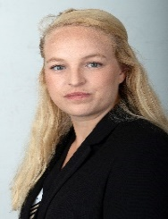
Frankfurt, Germany
Nell Poehlman Director Germany and Central Europe & Deputy Foreign Offices Director
Nell Poehlman serves as Director Germany & Central Europe & Deputy Foreign Offices Director with the Missouri Department of Economic Development. Nell is based in Frankfurt, Germany but originally from Columbia, Missouri.
She brings a wealth of experience to her role, specializing in trade projects for international clients across diverse sectors. Nell has spearheaded numerous government-funded programs and trade missions, collaborating with government clients to private entities in automotive, beauty, food and beverage, and energy sectors. Her expertise extends to leading projects and missions with companies from Canada, Wales, and the country of Georgia, highlighting her ability to navigate global partnerships effectively.
In her role with the US State of Missouri, Nell played a critical role in organizing and implementing the Governor’s trade mission to Italy in May 2024 and UK and Beglium in July 2024. She has also supported many Missouri companies in market entry program into Germany such as partner search, market research, and trade show support. An important highlight is that she guided the German company ESRA GmbH through the foreign investment process, leading to their eventual founding in Missouri as frogfish.
Before joining OCO Global, Nell spearheaded initiatives to foster cooperation between German and US stakeholders, not only in business but also in public diplomacy. Her responsibilities included organizing delegations and implementing market entry programs across diverse industries such as food and beverage, aviation, green buildings, civil security, and automotive lightweighting.
Nell holds a master’s degree in international relations and a Juris Master in International Law and Legal Studies from Universiteit Leiden. She is fluent in both English and German, with a basic understanding of French and Dutch.

Slide 3
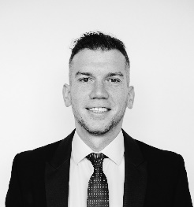
London, UK
Timothée Calame Director UK and Ireland
Timothée Calame serves as Director United Kingdom and Ireland for the Missouri Department of Economic Development. He is based in London, England.
Timothée is an international trade & investment consultant with 5 years of experience in the sector. Since joining the Missouri team at the beginning of the year, Tim has assisted several Missouri companies in understanding the UK & Irish markets and finding partners there. He also successfully led a delegation of Missouri companies to Farnborough Airshow in July and contributed to Governor Parson’s mission in London in July 2024.
Tim started with OCO in 2019 as a research analyst in Belfast working on projects that covered the UK, Irish, French, Swiss and Belgium markets. Tim was part of the representation team in Europe for the State of Florida (Enterprise Florida) until end of 2023. Tim participated in the organization of the Lieutenant-Governor led Florida delegation to Farnborough Airshow in 2022 and Governor De Santis' visit to the UK in April 2023. Tim's other clients have included the UK Department for Business and Trade, the Embassy of Switzerland in the UK, The French regions of Auvergne-Rhône-Alpes and Hauts-de-France, or the Australian Embassy in France.
Prior to joining OCO, Tim worked as a sales consultant for the American Tech company GoDaddy. Before that, he was in the communication department of the Swiss NGO Imbewu, which is active in South Africa in the field of sport and youth empowerment. Tim performed his national military service in Switzerland becoming a sergeant, during his studies.
Tim is half Swiss and half Northern Irish and holds Swiss, British, and Irish citizenship. He lived, studied, and worked in these three countries as well as in the US for a year. Tim holds a Master’s degree in International Relations from Ulster University in Northern Ireland and is fluent in French and English with a working knowledge of Spanish and German.

Slide 4
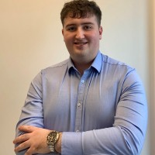
Belfast, UK
Ruairi McAteer Trade Specialist Europe
Ruairi is an experienced international trade and investment specialist, representing the state of Missouri as an International Trade Specialist focused on the European market.
Based in Belfast, Northern Ireland, he joined OCO in 2023 as a research analyst, working on projects across the UK, Georgia, and North America. Ruairi has played a key role in supporting Missouri-based companies, including organizing a successful governor's mission to Italy in May 2024, where he assisted a logistics company with meeting arrangements and the full agenda. Additionally, he was instrumental in coordinating the agenda for the Farnborough International Airshow in July 2024, supporting a major Missouri company.
He has provided trade-focused assistance to various Missouri companies in market entry programs across Europe, including partner searches, market research, and trade show support. Ruairi’s other clients include the UK Department for Business and Trade, USAID, and Enterprise Georgia.
Ruairi holds a Bachelor's Degree in Business Economics from Ulster University in Northern Ireland, where he developed a deep understanding of economic theories and concepts.

Slide 5
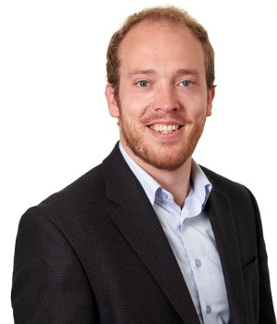
New York City, USA
Ian Hunter Director, USA
Ian Hunter serves as Director USA for the Missouri Department of Economic Development and is based in New York City.
An experienced FDI practitioner, Ian joined the Missouri international team having served as VP of Business Development for Invest Northern Ireland. Based in San Francisco and covering 14 US states and the west coast of Canada, he embedded himself in the west coast’s key networks - building strong VC relations on Sandhill Row with Sequoia Capital, Foundation Capital, ForgePoint Capital, 100 Start-Ups and YCombinator. Ian spearheaded a new market strategy, identifying key primary and secondary markets by creating bespoke sector research, channel engagement strategies and propositional materials. His initiative brought over 1,100 jobs to Northern Ireland, worth £55 million to the local economy each year. ​
During his career, Ian has delivered a series of training, strategy and stakeholder consultations that have been focused on understanding and implementing best practice processes in attracting international investment. ​​
Ian has extensive experience in in FDI analysis of geographies, sectors and companies. He has produced a number of reports, each client specific, focusing on their specific criteria and identifying their regional strengths. He is also an expert in developing sector and client propositions to assist in the investment decision making process. His client experience spans Europe, the Americas, the Middle-East and Asia-Pacific. ​​
Ian holds an English and History Degree (First Class) and a Masters in European Integration and Public Policy (Distinction) from Queens University Belfast.

Slide 6
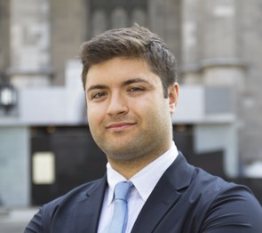
Montreal, Canada
Arnaud Prefontaine Deputy Director, Canada
Arnaud Prefontaine serves as the Deputy Director Canada for the Missouri Department of Economic Development and is based in Montreal.
With a Master’s in Public and International Affairs from the University of Montreal, Arnaud has built his career on facilitating cross-border business growth and fostering international trade relationships.
Arnaud has played a pivotal role in assisting more than a hundred U.S. companies from a wide range of industries to enter and navigate the Canadian market. His expertise lies in helping these companies understand the intricacies of Canadian regulations, assess competitive landscapes, and successfully establish their presence in Canada.
Arnaud has also demonstrated a strong ability to identify and engage Canadian businesses looking to expand their manufacturing operations into the U.S. Midwest region. His understanding of both the Canadian and U.S. business environments has enabled him to bridge the gap between these markets, providing valuable support to companies on both sides of the border.

Slide 7
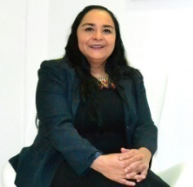
Mexico City, Mexico
Elizabeth Gallardo Director, Mexico
Elizabeth Gallardo serves as Director Mexico for the Missouri Department of Economic Development and is based in Mexico City.
Elizabeth has 28 years of experience in assisting individual companies in how to do business in Mexico & Latin America, as well as 9 years of experience in investment in Mexico, USA, Canada, Spain, Colombia, and Ireland.
Elizabeth has a wealth of experience working with US, European and Asian Trade & Investment Organizations such as: Enterprise Ireland, IDA Ireland, Promo Madrid, Manitoba Trade, Quebec MRI, Ontario Trade & Investment, OSEC, Uruguay XXI, PROESA, Chiletec, APEX, and KITA. Working closely with international organizations and governments around the world from diverse cultures and backgrounds. Scoping and designing specific innovation research solutions and strategies to meet their needs regarding export promotion and foreign investment attraction.
Her experience includes market research, distributor identification, B2B Meetings, investment promotion and across a multi-sectorial spectrum with more than 20000 projects for the USA, Canada, Ireland, Switzerland, Turkey, Spain, Portugal, Korea, Netherlands, Colombia, Uruguay, Ecuador, Belize, Australia, South Africa, Switzerland, Brazil, Chile, El Salvador, and Mexican companies.
Elizabeth holds a BA in science of communications and master’s degree in foreign Trade and International Business from Intercontinental University.

Slide 8
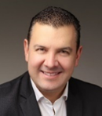
Sao Paulo, Brazil
Adalberto Bueno Director, Brazil
Adalberto Bueno serves as Director Brazil for the Missouri Department of Economic Development and is based in Sao Paulo.
Adalberto provides delivery oversight and execution of the Brazil operation, C-level and Government executive liaison to Missouri DED as the key executive supervising the delivery of the Brazil office in Sao Paulo.
Adalberto has over 20 years of local and international experience in trade and investment in Brazil and abroad. His international experience spans +19 countries in Latin America and his domestic experience covers all regions of Brazil. He has actively supported dozens of local and international IPAs and EDOs targeting Brazil or from Brazil aiming global markets. On his previous capacity as President of Invest Parana, he led the business matching of investors and exporters across several sectors with synergy with Missouri like Advanced Manufacturing, Biosciences, Professional Services, Information Technology, Energy Solutions and Health Sciences. As OCO Director for South America, Adalberto assisted major EDOs and IPAs interested to do business with Brazil or with the US in sectors like Education, Business Services, Energy, Agribusiness, Advanced Industries among other 20 industries.
His extensive business networks in Brazil covers many of the industry associations in the above-mentioned industries plus the market leaders (both indigenous Brazilian firms as well multinationals firms operating in Brazil).

Slide 9
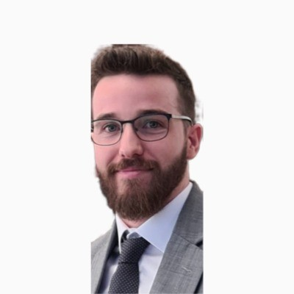
Dubai, UAE
Tristan Hawkey Deputy Director, UAE & GCC
Tristan Hawkey serves as Deputy Director UAE & GCC for the Missouri Department of Economic Development and is based in Dubai.
Tristan joined the Missouri international team in January 2024 but has been working as a market entry expert since 2020, helping international businesses within the technology, healthcare, and trading sectors to navigate, enter and succeed in the Middle East. Tristan has worked closely with numerous international trade bodies such as the U.K. Department for Business & Trade, Invest Northern Ireland, Welsh Business and Trade, Enterprise Estonia, New Zealand Trade & Enterprise and Colorado Economic Development.
Prior to moving to the UAE, Tristan worked as a Business Development Manager for a New Zealand FinTech start-up. In addition, Tristan previously sat on the advisory board of one of New Zealand's top research firms. T
Tristan received first class honors from the University of Canterbury in New Zealand for Masters of Commerce and was awarded numerous times in Entrepreneurship Competitions. He was a member of the winning team for New Zealand Young Enterprise. He is fluent in English.

Slide 10
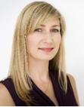
Tel Aviv, Israel
Elysa Rapoport Director, Israel
Elysa Rapoport serves as Director Israel for the Missouri Department of Economic Development and is based in Tel Aviv.
Elysa has 16 years’ experience in international business development, marketing, strategic communications, and events management, in the hi-tech, government and non-profit sectors in Israel and internationally. In her this capacity as Director Israel, Elysa provides assistance to Israeli hi-tech companies interested in entering the US markets, increasing the interest of investors in Missouri by promoting the state of Missouri as an attractive business location and supporting DED as well as Missouri partner organizations.
Elysa also provides assistance to Missouri firms looking to export to Israel regarding market entry, strategies and objectives for exporting products and services. Since its opening, the office has already made over 500 business development contacts in Israel, has hosted three Governor led business & trade delegations to Israel.
Elysa has also worked for leading Israeli NGOs including the Peres Center for Peace, where she secured large-scale grants, developed strategic partnerships, managed the organization's marketing and communications and managed high profile international events and delegations. Elysa is a founding member of B Corp Israel, where she assists Israeli social businesses to measure their social and environmental impact and gain access to international markets and impact investors.
Elysa holds a Bachelor’s Degree in International Relations from the University of New South Wales, Australia, and a Master’s Degree in Political Communications from Tel Aviv University. She was born in Australia and has lived in Israel for the past 15 years. She speaks fluent English and Hebrew.

Slide 11
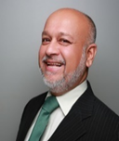
Pune, India
Nitin Pangam Director, India
Nitin Pangam serves as Director India for the Missouri Department of Economic Development and is based in Pune.
Nitin works closely with economic development and corporate clients on trade facilitation, exports to India / South Asia, and India entry. Since 2011, Nitin has served as the India Director of Missouri International Trade and Investment (MITI), where his primary focus is managing the India office for both trade and investment. To date, Maeflower has supported over 200 SMEs from Missouri looking to increase exports to India by developing market and sector opportunity reports, identifying clients and partners.
In addition, Nitin is a consultant to the World Bank Group and has assessed several Indian states’ preparedness to attract and facilitate FDI. He has developed global expansion strategies for numerous companies, guiding their operations setup and transition into new markets. His expertise includes program development, SME internationalization support, capacity building, and export assistance.
Nitin has spoken at several Trade & forums, including the SBA Annual conference in Washington, IEDC conferences in Philadelphia and Houston, the DTI Policy Conference in South Africa, and WTCs across the US Mid-west.

Slide 12
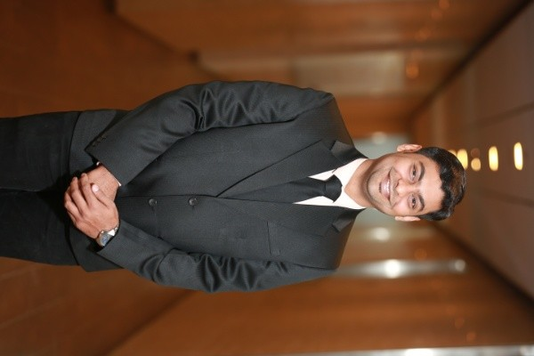
Pune, India
Shrikant Chaudhari Deputy Director, India
Shrikant serves as Deputy Director India for the Missouri Department of Economic Development and is based in Pune.
He has 10 years of experience in project management, key account management, business operations, and client delivery, as well as in the execution of market research, policy consulting, and investment attraction projects. He has successfully managed investment attraction projects, trade and export promotion, support, facilitation projects, and consulting. Shrikant has assisted over 100 SMEs from the US in entering the Indian market, focusing on export promotion and enhancing their product and service visibility. His capabilities include proficiency in qualitative and quantitative analysis, client presentations, business and operational excellence, team management and coordination, and overall project oversight.
Since 2016, Shrikant has specialized in facilitating trade between Missouri SMEs and the Indian market. His expertise includes market research, competitor analysis, agent and distributor identification, and policy consulting. Shrikant has played a pivotal role in advancing Missouri business interests in India and promoting Missouri exporters. Shrikant also offers strategic support to Indian companies exploring opportunities in Missouri, including site selection for manufacturing, R&D centers, and distribution facilities. He provides comprehensive guidance on costs, resource availability, government incentives, and other critical factors, showcasing the benefits of establishing operations in Missouri.

Slide 13
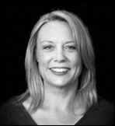
Melbourne, Australia
Jayne Hunt Director, Australia
Jayne Hunt serves as Director Australia for the Missouri Department of Economic Development and is based in Melbourne.
Originally from the UK and now based in Melbourne, Jayne is a multilingual (French and Spanish) international trade professional with over 25 years’ hands-on experience creating and implementing successful trade promotion and investment strategies for both public sector and private sector clients. She has been working with the Missouri Department of Economic Development since the inception of the Australia Office in 2022.
She has a consistent track record of generating new trade and FDI opportunities in various sectors by developing strong relationships with major global players, stakeholders, importers and distributors across diverse markets including Australia, Asia, Europe, North America, the Middle East and the UK.
During her career, she has acquired a vast knowledge of the technicalities of international trade as well as a good understanding of the global supply chain and routes to market. Jayne has also worked on associate consultant contracts for the UK’s Department for Business and Trade as well as with many SMEs and large-scale businesses.

Slide 14
Tokio, Japan
Kazuyo Tsuneizumi Director, Japan
Kazuyo Tsuneizumi serves as Director Japan for the Missouri Department of Economic Development and is based in Tokio.
Kazuyo leads Missouri's in market presence. She promotes the State as a trade and investment partner of choice working with both Missouri HQ'd companies and Japanese existing and prospective investors.
She is an experienced marketing and brands professional specializing in business development, marketing strategy, PR and communications. In addition to her economic development work she has supported a range of global brands to successfully position, partner, launch and build communities in one of the world’s most valuable, significant and sophisticated markets. Her focus with Missouri based SME’s supports their efforts engaging importer and distributor networks to build and enhance sales and marketing strategies for success in Japan.
She has successfully delivered a wide range of project assignments making significant contributions many involving management of high level relationships with key channel partners and multiple stakeholders. This included a highly successful Governor led mission to Japan in October 2023.
Kazuyo is the Missouri representative for the American State Offices Association in Japan.

Slide 15
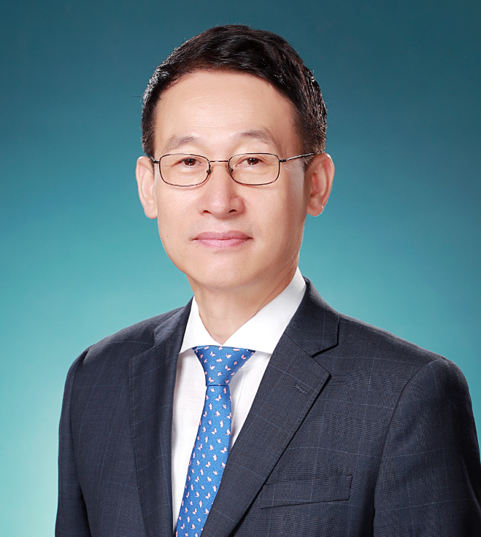
Seoul, South Korea
Ken Yang Director, South Korea
Ken Yang serves as Director South Korea for the Missouri Department of Economic Development and is based in Seoul.
Ken is a highly accomplished business development professional with over three decades of experience in promoting U.S. products and services to the South Korean market. In his new role as Director South Korea with the State of Missouri, he collaborates closely with local businesses, trade organizations, and government agencies to foster and facilitate trade and investment opportunities for the State of Missouri.
Ken has a proven track record of developing and executing successful market entry strategies for American companies, encompassing market research, partner search, market visits, and trade show participation. Ken has also spearheaded the organization of trade missions and seminars to connect American businesses with potential customers and partners in South Korea, significantly expanding their market reach
Additionally, Ken has provided insightful consulting services on various topics, including export finance, customs regulations, cultural differences, and other critical aspects of doing business in South Korea.
Ken received a MBA in International Business from Sogang Graduate School of Business Administration.

Slide 16
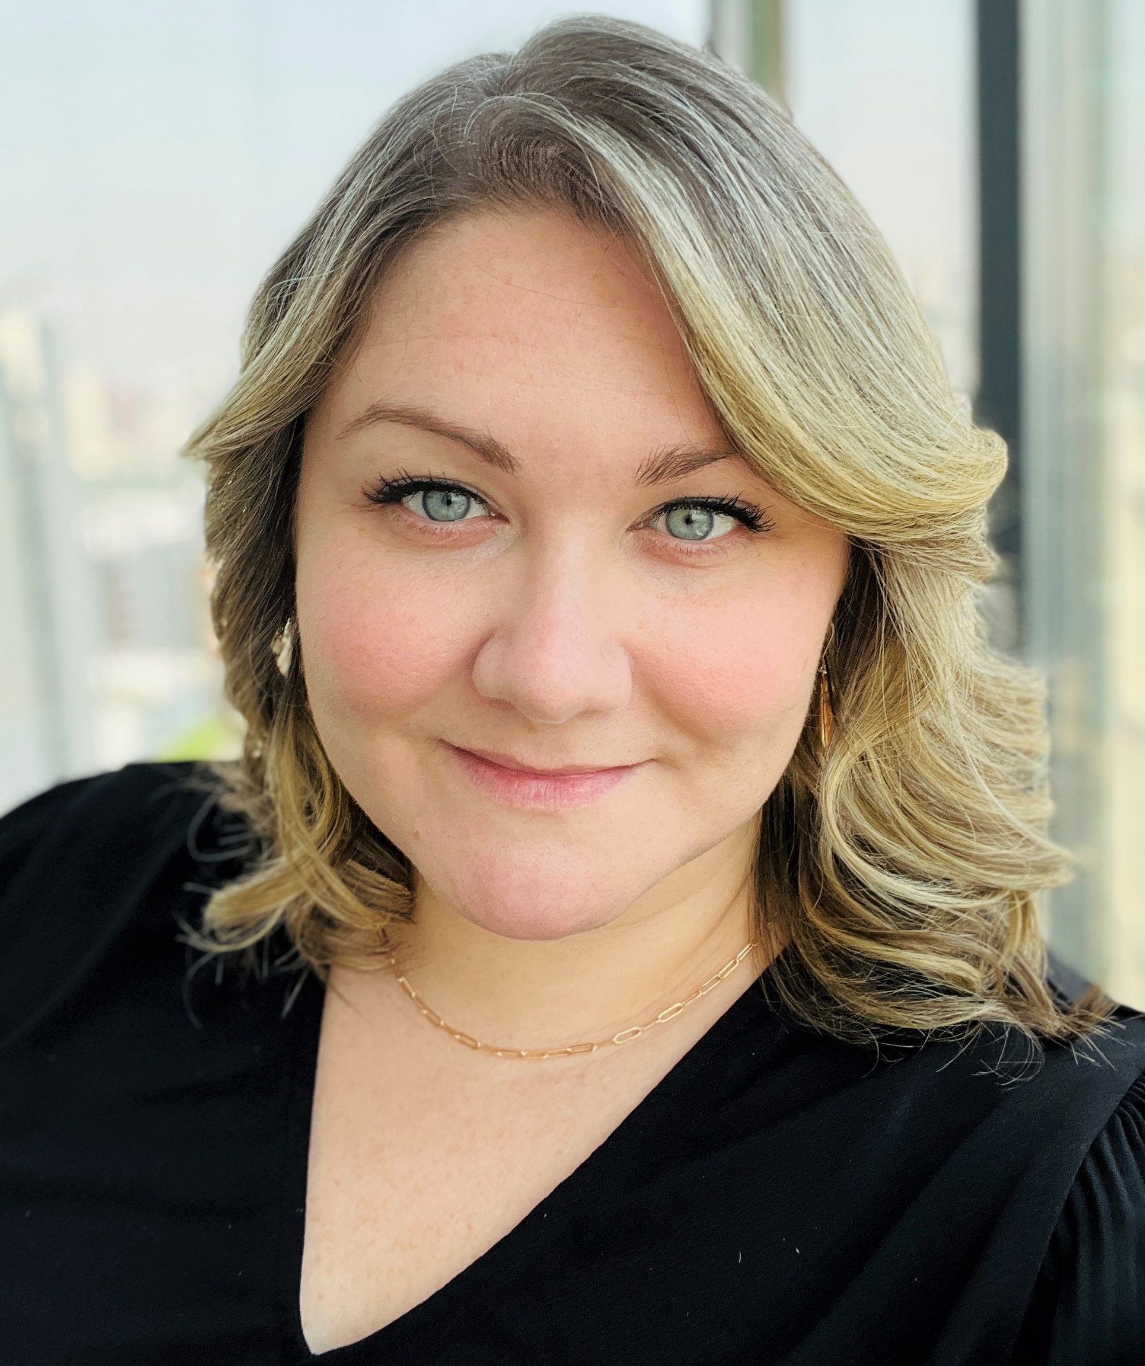
Missouri, USA
Shannon O’Hagan Managing Director, International Trade & Investment Office
Shannon O’Hagan joined the Missouri Department of Economic Development in March 2024. As Managing Director for the International Trade and Investment Office, Shannon leads a Missouri-based team of international trade specialists and coordinates with the state’s Global Office Network to support Missouri companies with export and trade development. She also directs federal and state international marketing cost-share programs.
Shannon is actively engaged with state trade partner organizations and is a council member for the Missouri District Export Council.
Shannon’s prior professional experience includes 12 years in international mobility with specialization in attracting international students to study at state universities. She has also worked in graduate medical education and business.
Shannon holds a Bachelor of Science degree in Management and a Master of Science degree in Student Affairs from Missouri State University. Shannon resides in Blue Springs, MO but enjoys traveling. She has visited 39 U.S. states and 44 countries on five continents.

